Slide 1
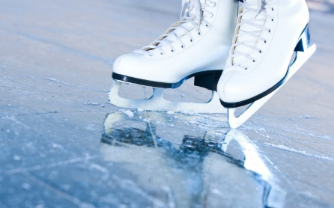

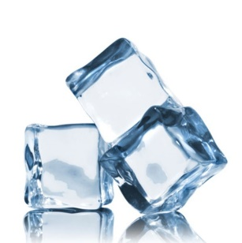
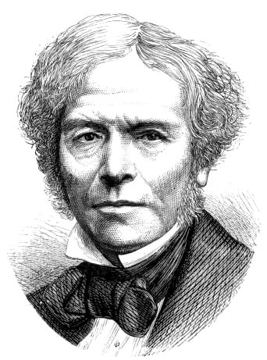
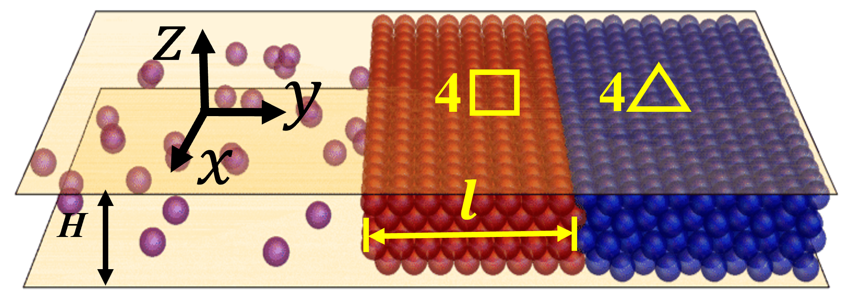
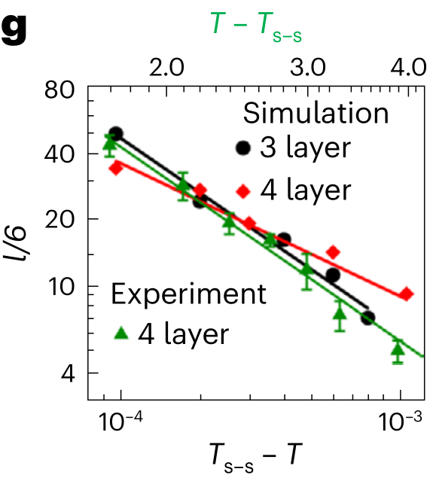
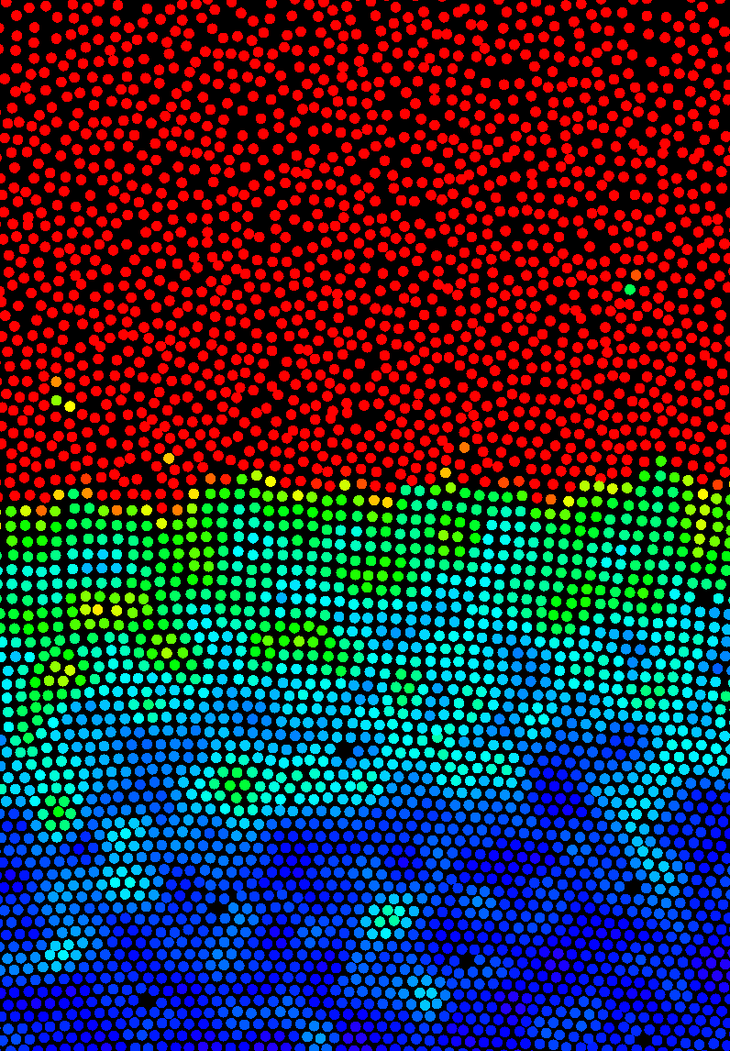
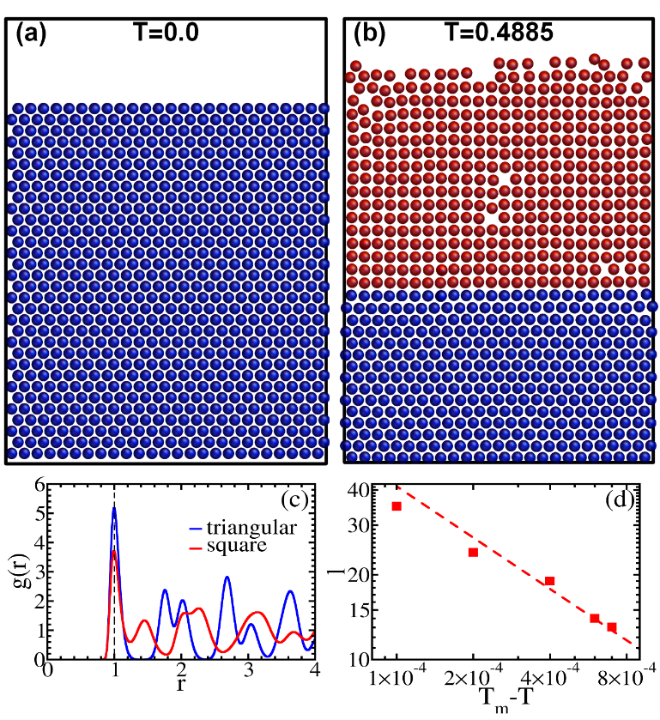
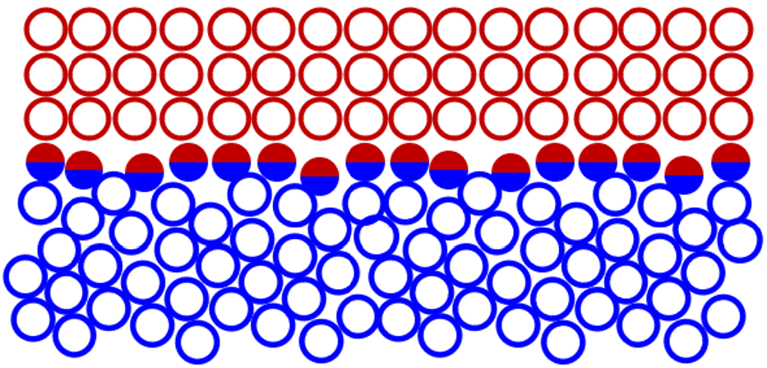
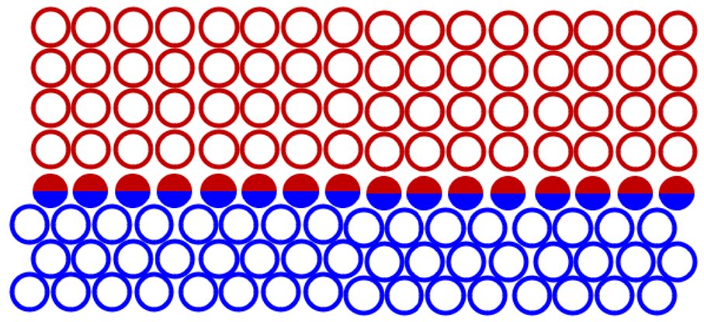
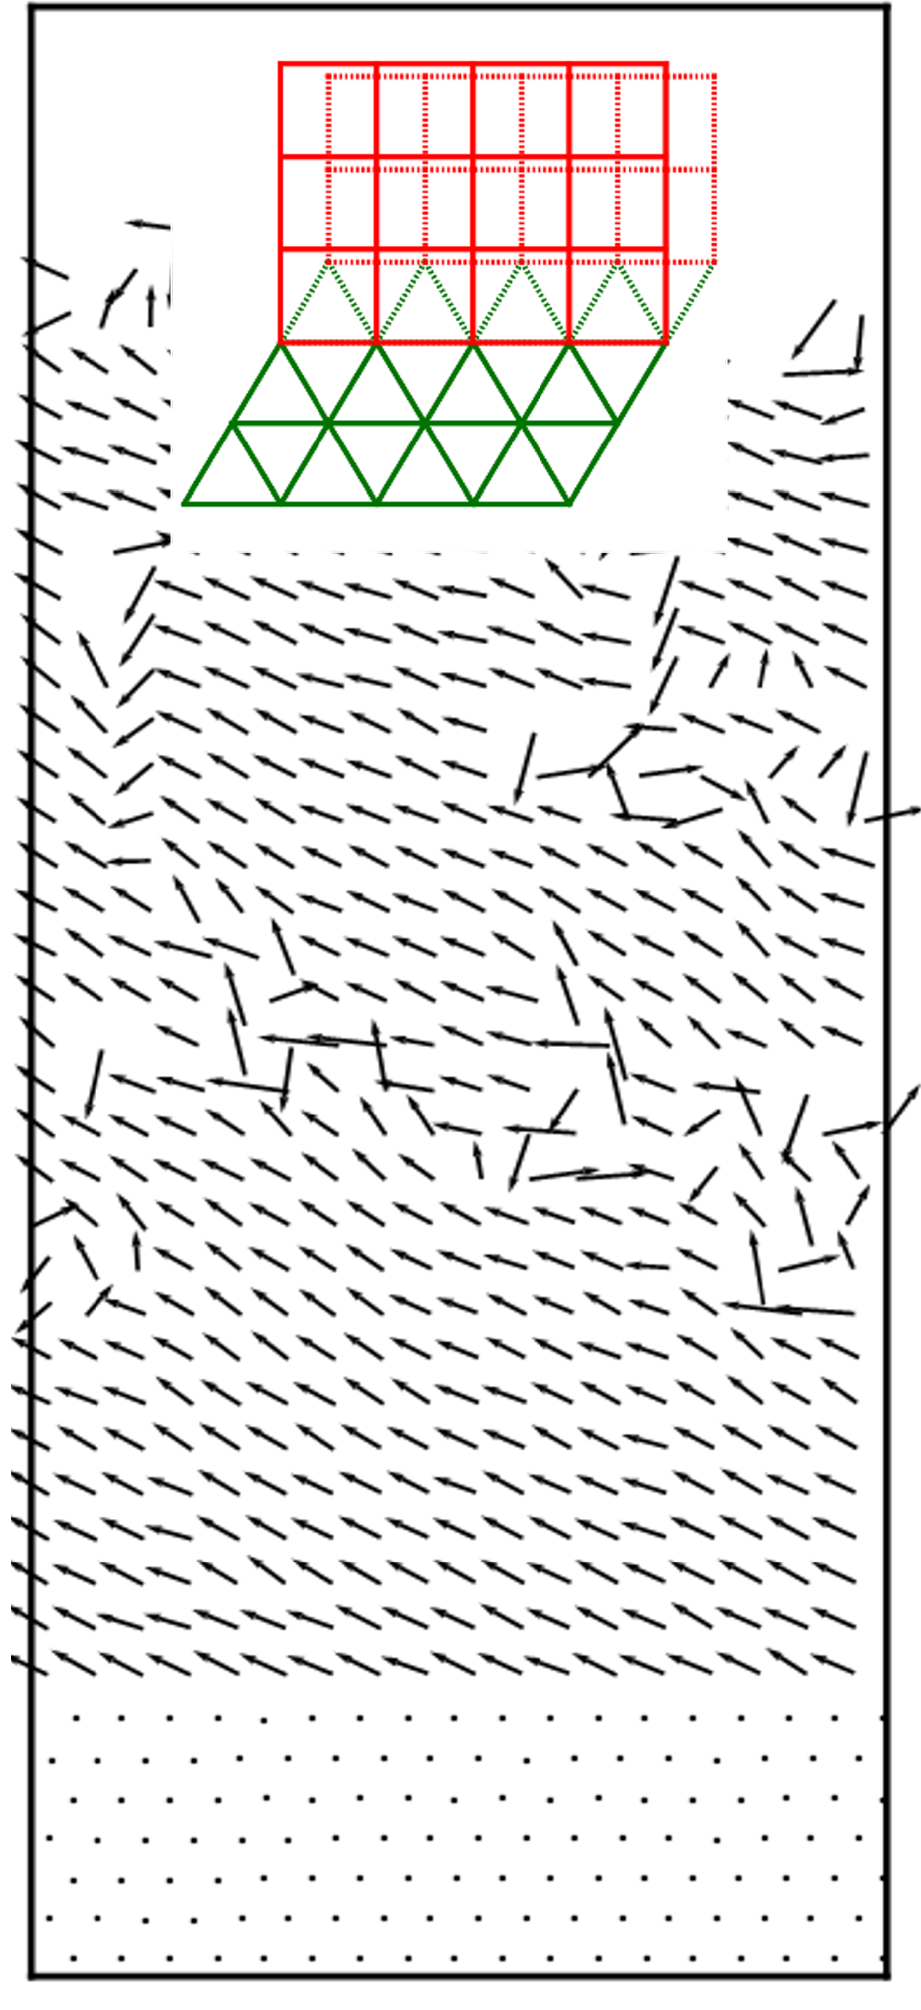
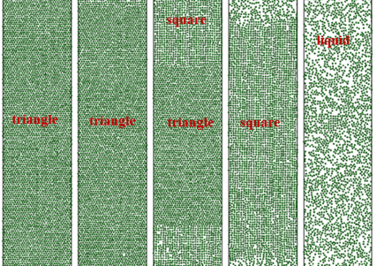
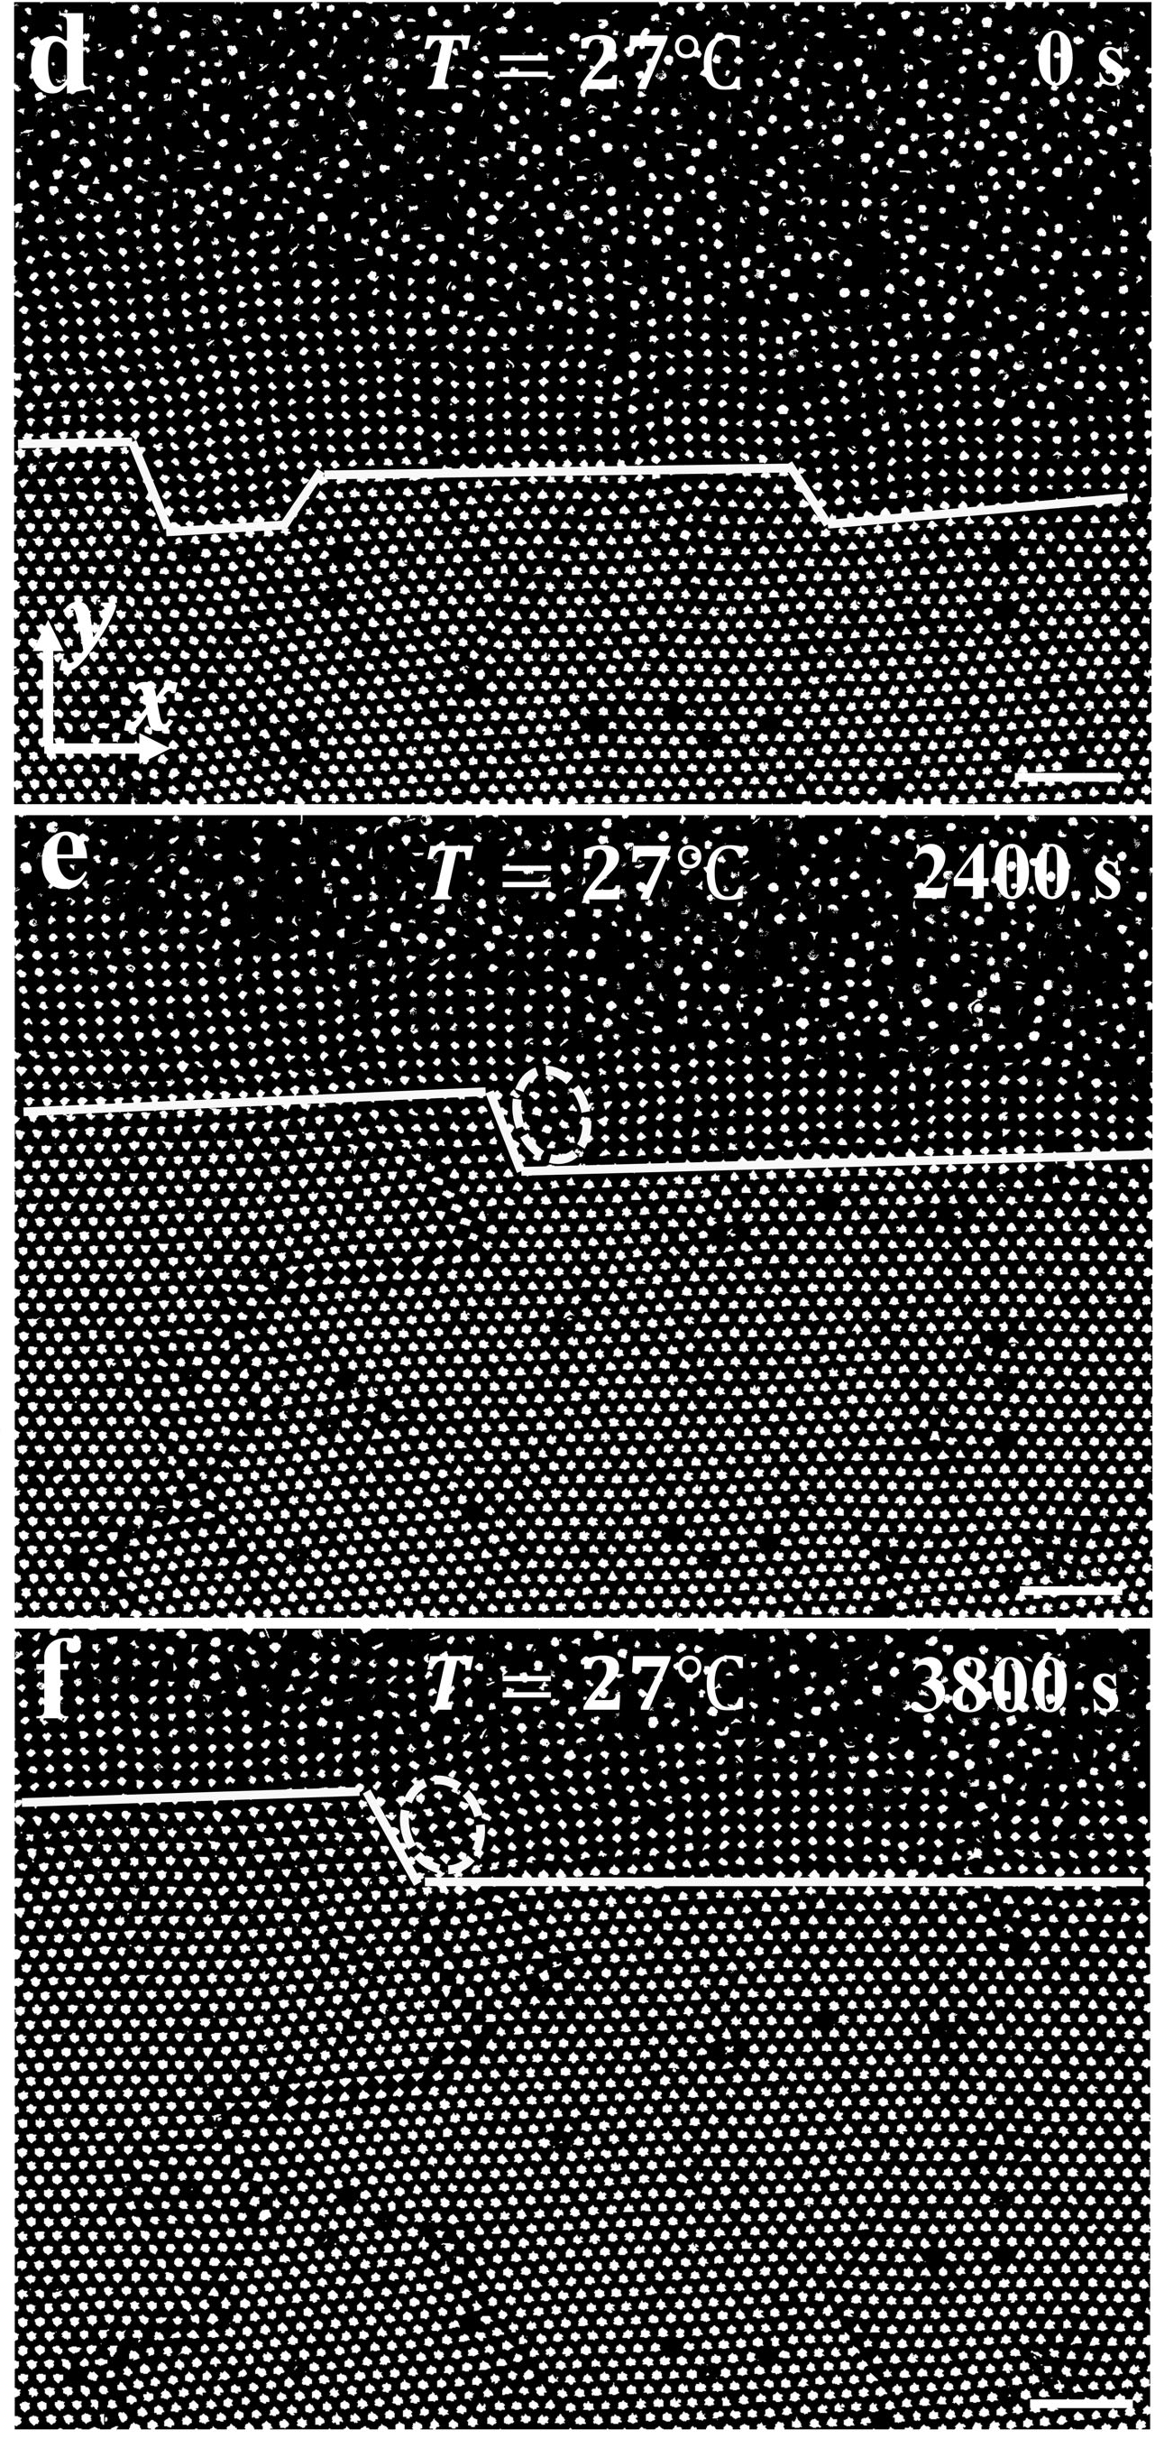
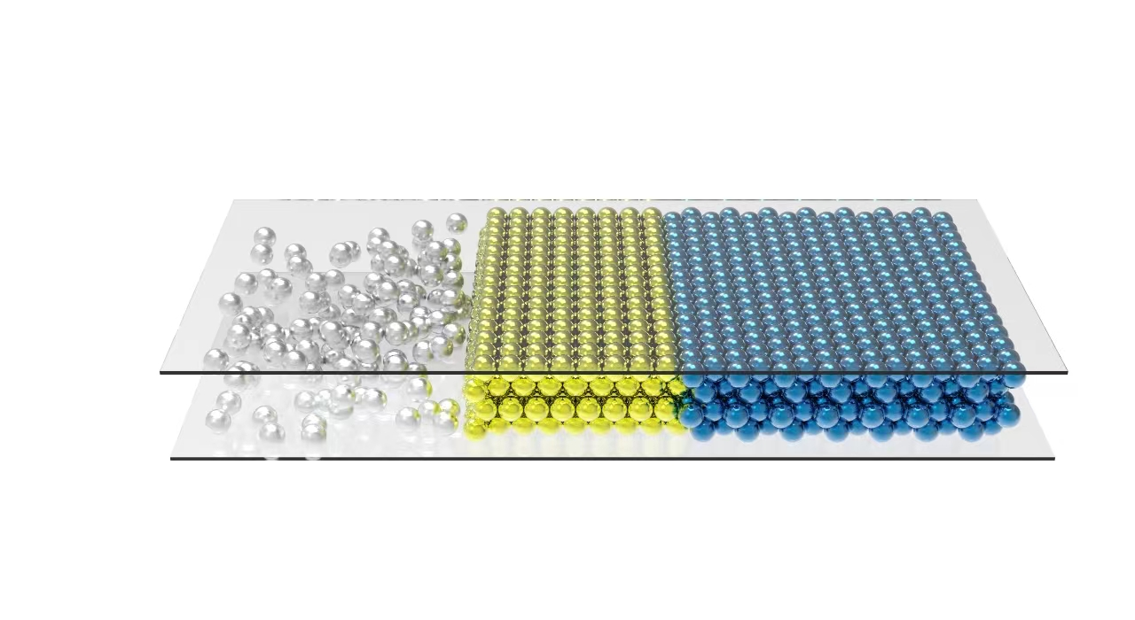
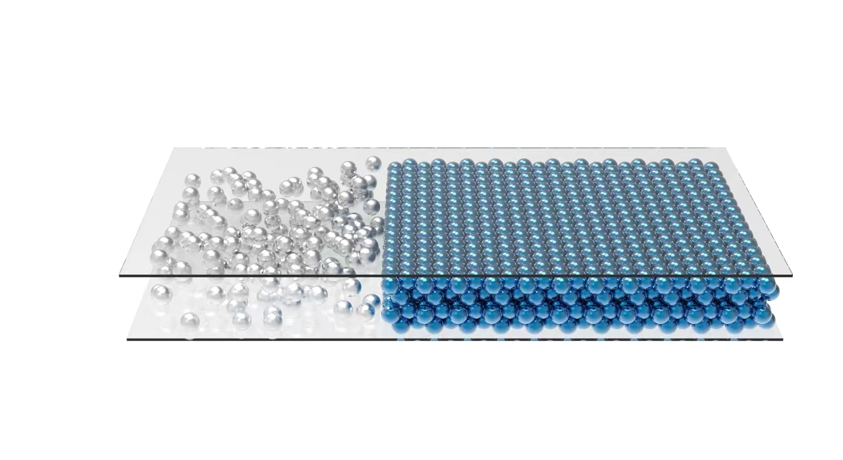
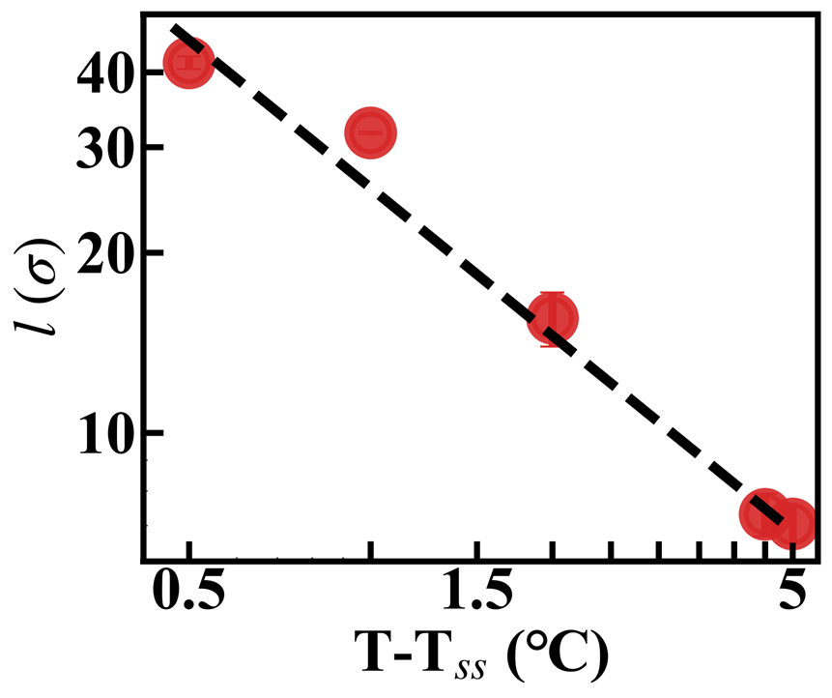
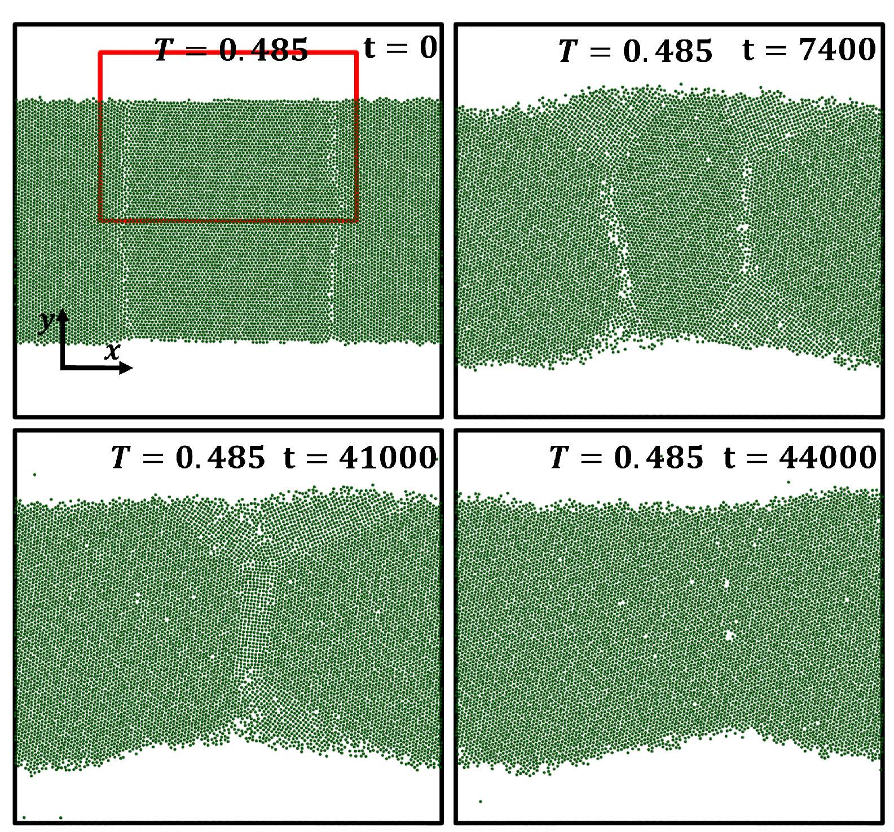
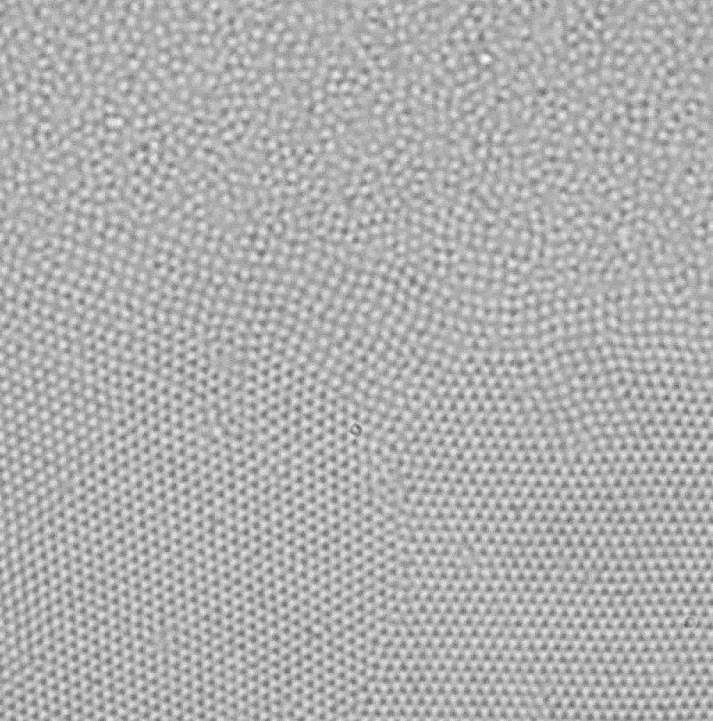
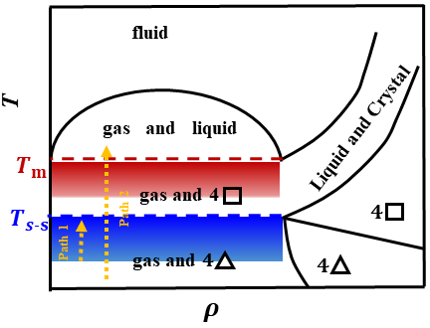
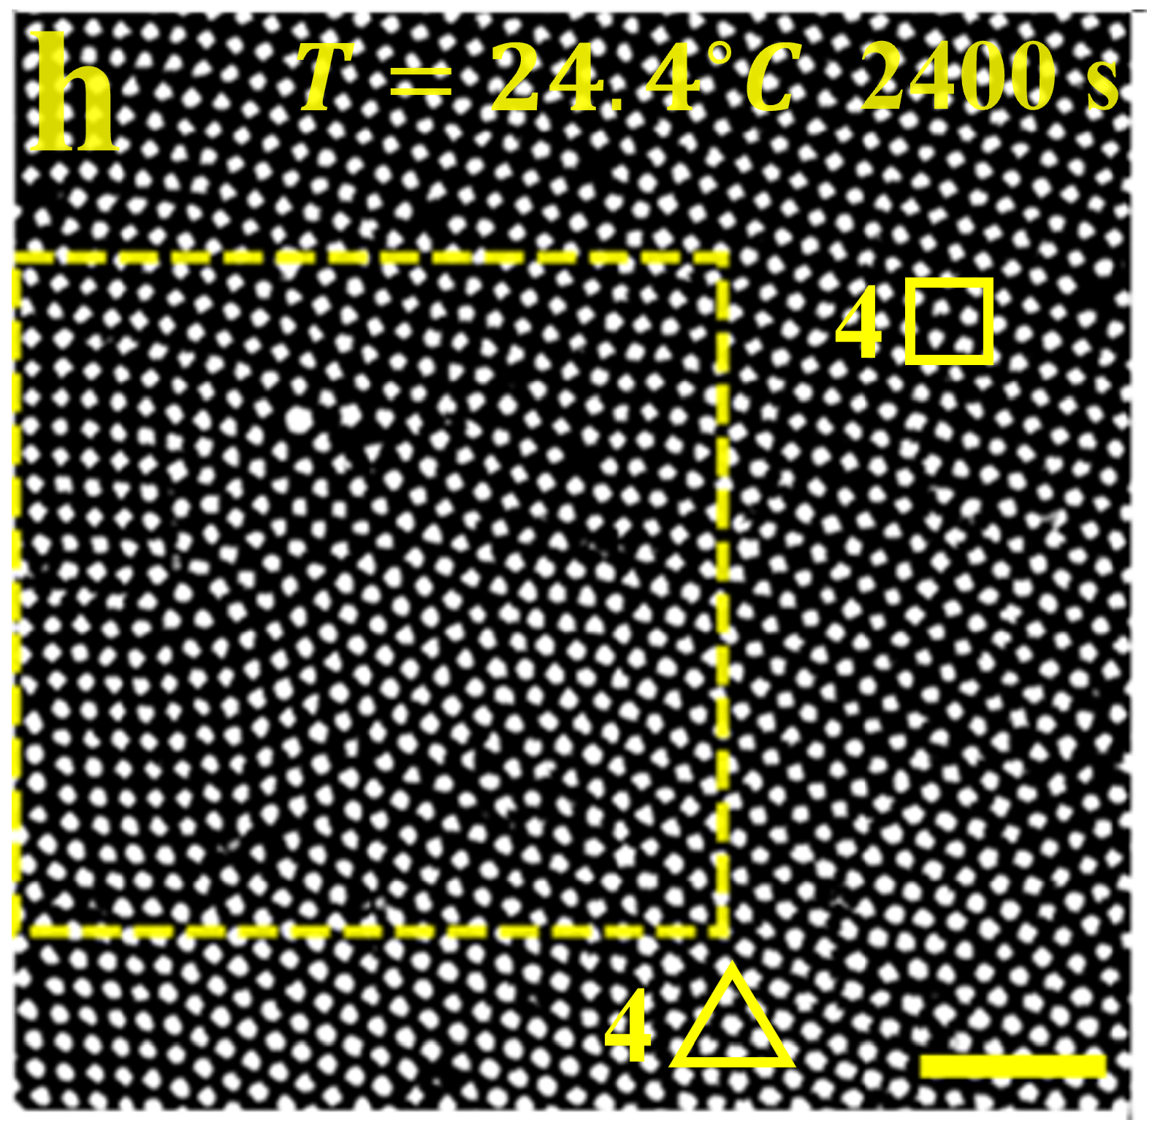
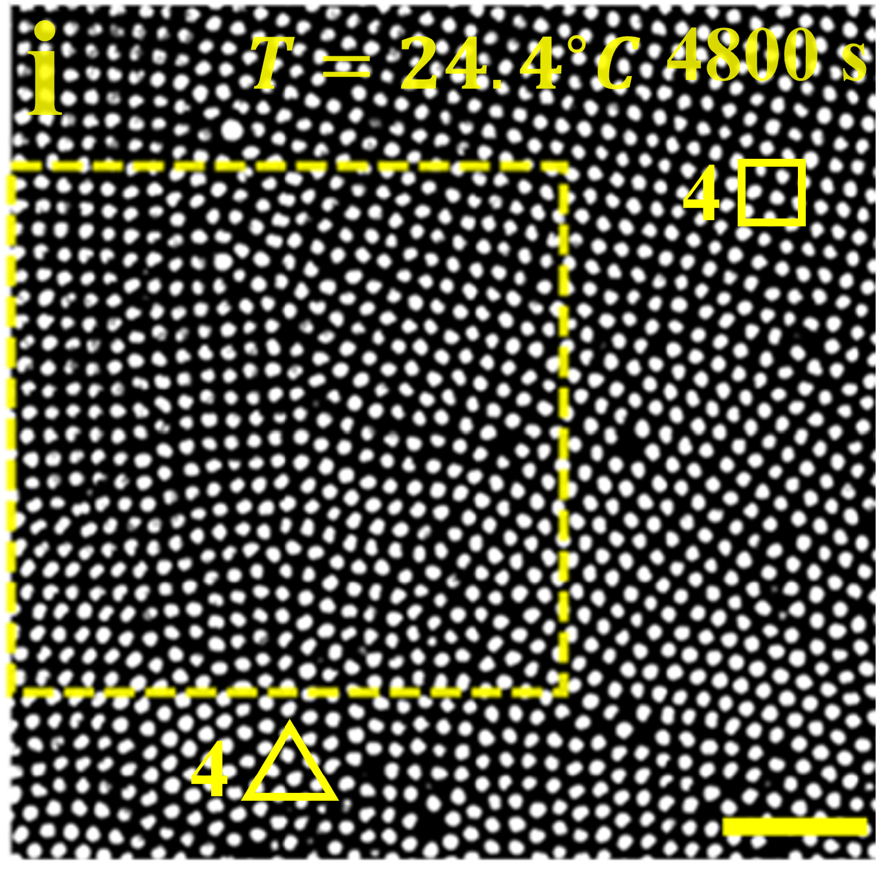
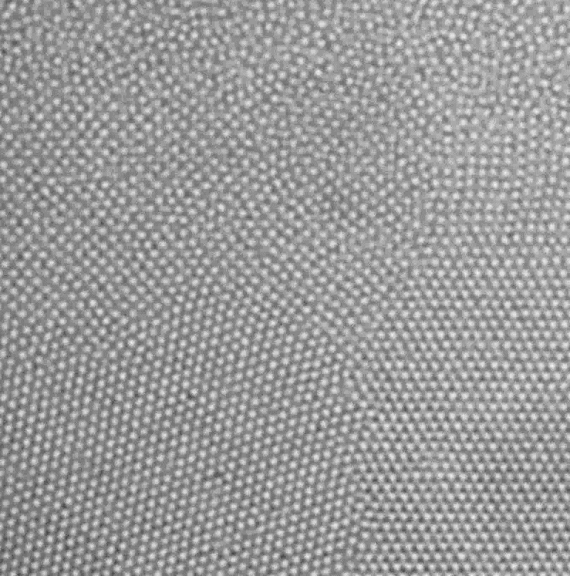

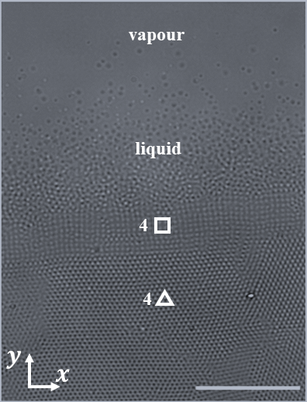
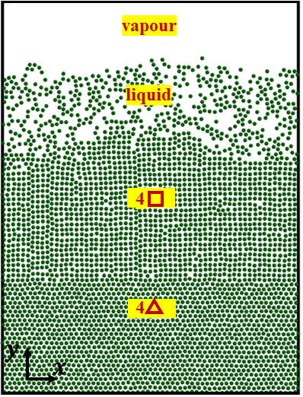
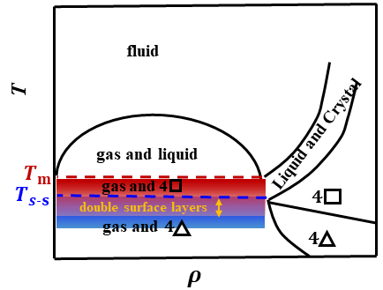
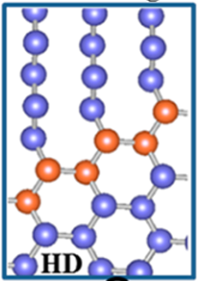
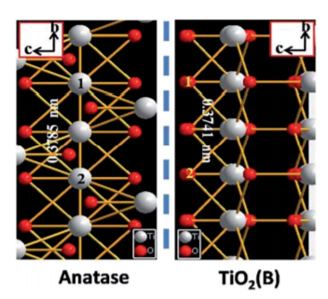











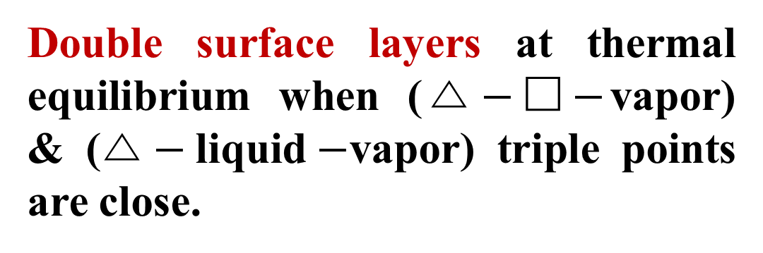



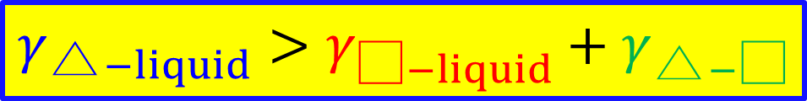



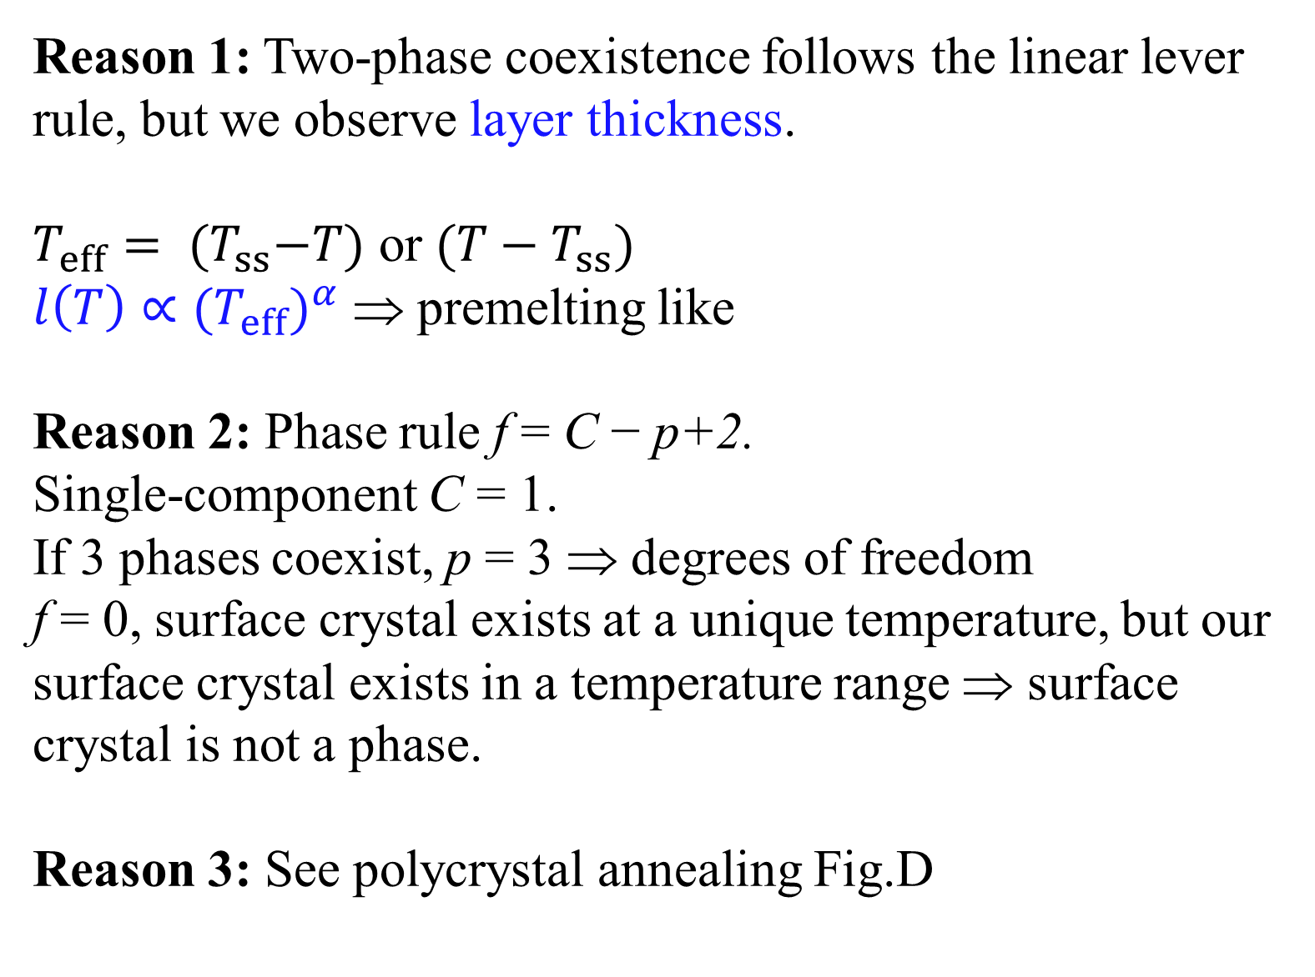
Polymorphic crystalline wetting layers on crystal surfaces
Department of Physics, Hong Kong, China
Mengmeng Li 李萌萌, Xipeng Wang 王锡朋, Bo Li 李博, Yilong Han 韩一龙
Background: two known phenomena
Under Thermal Equilibrium
Premelting
Pre-solid-solid transition:
Not trivial two-phase coexistence above T_{ss}:
A thin layer of liquid formed on crystal surface slightly below the melting temperature
Exist on most crystals’ surfaces
Important in skating, glacier movement...
Conjectured by Faraday in 1842
Experimentally confirmed in 1980’s
First observation at the single-particle level
B. Li, F. Wang, D. Zhou, Y. Peng, R. Ni, Y. Han, Nature 531, 485 (2016)
Crystallization slightly above the freezing temperature, e.g. on a flat or commensurate substrate
Proposed and observed in 1950-1970’s
We propose pre-solid-solid transition: A polymorphic crystalline wetting layer on crystal surfaces slightly before reaching the solid-solid transition
Example: If a diamond’s surface could form a thin layer of
graphite before reaching their solid–solid transition
temperature, then it will be a pre-solid–solid transition.
Observed it in colloid experiment and simulation
  Colloid: Micron-sized particles dispersed in liquid; Good model system for phase transition studies because particles’ thermal motions can be imaged and tracked even inside 3D bulk by optical microscopy.
Phase behaviors under thermal equilibrium are well understood.
Thus, this discovery of a new thermal-equilibrium phenomenon is remarkable.
Reason 1: Two-phase coexistence follows the linear lever rule, but we observe layer thickness.
$T_{eff}= {(T}_{ss}−T)$ or ${(T−T}_{ss})$
${l\left(T\right)∝{(T}_{eff})}^{α}$ ⇒ premelting like
Reason 2: Phase rule f = C − p+2.
Single-component C = 1.
If 3 phases coexist, p = 3 ⇒ degrees of freedom
f = 0, surface crystal exists at a unique temperature, but our surface crystal exists in a temperature range ⇒ surface crystal is not a phase.
Reason 3: See polycrystal annealing Fig.D
bulk
Michael Faraday
Father of electricity
Experiment
Simulation
Prefreezing
4△
$$T_{eff}$$
Our result: a new phenomenon
liquid
□ lattice
4□
diamond
△ bulk lattice
4△ bulk
graphite?!
10$μm$
Mechanism:
The surface energy is lower when surface tensions γ satisfy the wetting condition
× incoherent interface
liquid or vapor
△ lattice
liquid or vapor
□ lattice
△ lattice
large γ
$$γ_{\text{△}−liquid}>γ_{\text{□}−liquid}+γ_{\text{△}−\text{□}}$$
√ coherent interface
γ ≈ 0
In non-equilibrium processes
Kinetics of layer growth
Melting
Crystallization
Two-step crystallization
One-step crystallization
$$y_{1}$$
$$y_{0}$$
$$z$$
$$y_{0}$$
4□
4△
$$y$$
4△
Power law
$$l$$
$$x$$
$$l (σ)$$
Pre-ss
T4△-liquid
T
T4△-4□
/ T4△-4□-liquid
$${T−T}_{ss} (°C)$$
Prefreezing of 4□ during the crystallization of 4△
1. Collective row-by-row shift:
  Lennard-Jones particles in simulation
  Soft pNIPAM microgels in experiment
Polycrystal annealing
Transient surface 4 lattice during the melting of
4△ lattice (simulation of Lennard-Jones particles).
A B E
liquid
4□
4□
4□
lattice
4△ 4△ 4△
4△ 4△ 4△
30° GB
30° GB
4□
4□
30° GB
20$μm$
C D F
4△ 4△
5$μm$
Fluid ⇒ 4 ⇒ 4△ lattice. during the 4△crystallization, the thickness of 4 maintains a constant.
Deformed rhombic lattices (highlighted by ellipses) to maintain the coherent interface.
4□
4 rhombic lattice
20$μm$
Dashed arrows in the phase diagram represent the transient pathways of melting and pre-solid-solid transitions.
4△ 4□ 4△
Single 4△ lattice
2. Hard PMMA particles in experiment:
lattice distortion ⇒ defects
⇒ annealed away
4□
20° GB
4△ 4△
5$μm$
Pre-solid-solid and premelting coexistence
(A-D) simulation; (E-F) pNIPAM colloid experiment
Two grain boundaries (GBs) with a 30° mismatch angle.
4 lattices form at the GB–surface intersections, attracting the two GBs closer.
A band of 4 lattice with coherent  −△ interfaces formed during the GB coalescence.
Final equilibrium state is a △ lattice ⇒ It is a pre-solid-solid transition before reaching T_{s-s} instead of solid-solid coexistence after T_{s-s}.
Surface square lattice formed at 30$°$ GB.
When GB angle 20$°$ ≠ 90$°$ (square)$−$60$°$ (triangle), form surface rhombic lattice to make crystal-crystal interfaces coherent.
Experiment
Simulation
(C) Overlapped premelting (red band) and pre-solid-solid (blue band) regions in the phase diagram.
A B C
Double surface layers at thermal equilibrium when ($\text{△}−\text{□}−$vapor) & ($\text{△}−\text{liquid}−$vapor) triple points are close.
20$μm$
Possible atomic/molecular crystals with pre-solid-solid transition
Surface of the high-density crystal can form a lower-density polymorphic crystal if crystal-crystal interface is coherent.
Application: Guide to find novel crystal with tunable surface, useful material.
Graphite
Reference: X. Wang*, B. Li*, M. Li*, Y. Han, Nature Physics 19, 700 (2023)
This work is supported by the Hong Kong Research Grants Council.
(GRF-16302720, GRF-16305822, CRF-C6061-20G)
Lonsdaleite
(i.e. Hexagonal
diamond)
Notes:
Conclusion in abstract sigma → diameter skating color bar strain

